Slide 1

Predicting total domestic sales of a movie
Data source : Boxofficemojo.com
Pradnya Nimkar
Notes:
My project is about predicting total sales of a movie based on different parameters.

Slide 2

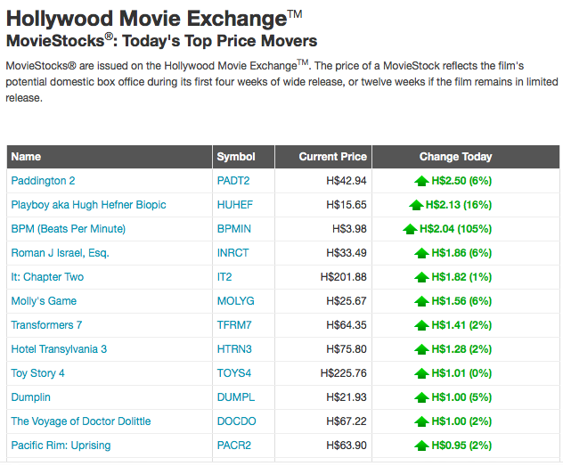
Target problem: “Popcorn Prediction”
Betting on a movie success is legal
Box office earnings are a commodity according to commodity Future Trading Commission
Notes:
Apparently, betting on a movie bussiness is legal. Commodity Future trading commission thinks of box office earnings as a commodity. There are websites like hollywood movie exchnage where you can buy and trade movie stocks.

Slide 3
Input variables data Range considered:
Number of theatres
Runtime
Distributors
Genres
Release Date ( Day and Month )
Production Budget
MPAA Rating
Actors
Directors
Composers
Considered 4 years of data (2014-2017)
Notes:
The Motivation behind the analysis
Good mix of continous and categorical variables

Slide 4
Data Adjustment Decisions:
Target variable (Domestic Sales) :
Adjusted for inflation
Input Variables :
Top 10 Distributors : Ranked by production budget
Female vs Male Lead Role
Friday Release Vs Other Days
Most Frequently Occurring Genres
Top 10 Actors
Production Budget : NaNs
Converted categorical variables to dummy variables
Notes:
Since I was looking at 4 years of data,
today's value
Based on Actor column:
Based on Release Date column
I focused on frequently occurring Genres. That made sure Genres I was considering had enough credibilty. Those that had less than 25 obeservations I grouped them in other categories.

Slide 5
Relationship Discovery:
Notes:
holiday time
Summer time
optimal Runtime -- 80-140
bend -quadratic
theatres -intuitive

Slide 6
Model Selection process:
Multiple Linear Regression
With Quadratic Effects for Runtime and Theatres
Removed Outliers
Lasso Regression
Notes:
baseline R square is for linear regression
that was 0.46
R-square of 0.46

Slide 7
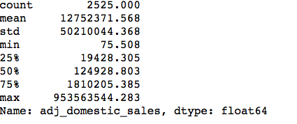
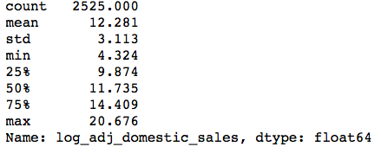
Transformation of target Variable:
The graph shows Actual values on X-axis vs. Predicted Values on Y-axis
Notes:
My R-square jumped to 57%
log -- monotonous function
shortens the range
Min =Confession of a Child of the Century (Released in one theatre)
Max = Star Wars: The Force Awakens

Slide 8
Residual Plot
Observed vs. Errors
Define every relationship explicitly
Observed
Random Forest!!!
Errors = (Observed – Predicted)
Notes:
The residual plot shows pattern
there is still some uncaptured pattern which could improve my predictions.
I had two choices – I could explicitly define every relationship including interactions.

Slide 9
Random Forest results
Graph of Actual vs Predicted
Actual. Values
Final R² = 82.5%
Variables in the order of importance:
Theatres (63.17%)
MPAA Rating (14.51%)
Top 10 Distributor (12.64%)
Runtime (4.85%)
Genre (2.77%)
Release Month (1.45%)
Friday Vs Other (0.59%)
Top 10 Actors (0.012%)
Predicted Values
Notes:
Did not use quadratic terms
'Buena Vista', 'Warner Bros.', 'Lionsgate/Summit', 'Fox'
MPAA Rating - PG,PG13, G and R
Genre -- Sci-Fi, Action/Adventure/ Fantasy and animation

Slide 10
Next Steps:
Read More Data!
Rigorous Data Quality Check
Cross validation
Include Top Directors and Composers as Input Variables
Try to find Supplemental Data Sources
Relationship with Economic Indices
Notes:
Data Quality : Top 10 actors not being predictive was surprising.

Slide 11
Thank you!

